Slide 1

ROAD SIGN DETECTION USING MAMBA TRANSFORMER
Department Of Computer Science And Engineering
A Deep Learning Approach for Real-Time Road Sign Detection
TEAM MEMBERS:
B. DHANASEKAREN (412321104005)
B. HEMANTH (412321104019)
R. KARTHI (412321104027)
GUIDED BY
Mrs. K. Lakshmi, M.E., Asst.Prof.
Sri Ramanujar Engineering College, Kolapakkam, Vandalur ,
Chennnai – 600127.

Slide 2
Abstract
Department Of Computer Science And Engineering
Developed a real-time traffic sign detection system using YOLOv5 and a custom Mamba Transformer
YOLOv5 detects signs; Mamba Transformer classifies them with improved accuracy
Achieves robust performance under real-world conditions with faster and efficient prediction.

Slide 3
Objectives Achieved
Department Of Computer Science And Engineering
Used Mamba Transformer and CNN to compare and classify road signs.
Leveraged CUDA GPU acceleration to train models efficiently.
Built a PyQt5 GUI with both light and dark themes for user-friendly visualization.
Captured live video using OpenCV from both laptop and mobile cameras.
Successfully implemented YOLOv5 for real-time road sign detection.
Logged detections and visualized analytics with Matplotlib graphs.

Slide 4
Literature Survey
Department Of Computer Science And Engineering
"You Only Look Once: Unified, Real-Time Object Detection" (YOLO)
Author: Joseph Redmon et al., 2016
Introduced the YOLO architecture enabling fast and accurate detection, widely adopted in autonomous driving.
"Traffic Sign Recognition with Deep Convolutional Neural Networks"
Author: Ciresan et al., 2012
Demonstrated deep CNNs can significantly improve traffic sign classification accuracy over traditional methods.
“YOLOv5: Real-Time Object Detection with Enhanced Speed and Accuracy”
Author: Glenn Jocher et al.
Introduced a highly efficient real-time object detection model widely used for traffic sign and road object detection, known for balancing accuracy with computational speed.

Slide 5
Existing System
Department Of Computer Science And Engineering
Traditional methods rely on color and shape detection — limited accuracy in complex scenes.
CNN-based models (e.g., YOLOv3, Faster R-CNN) improve detection but require high computational resources.
Transformer-based models offer better accuracy but are often too heavy for real-time or embedded applications.
Most current systems fail in real-time performance on low-power or edge devices — limiting use in autonomous driving.

Slide 6
Proposed System
Department Of Computer Science And Engineering
Unlike traditional Transformers, Mamba replaces attention with lightweight operations, making it suitable for real-time road sign detection on edge devices.
Uses YOLOv5 for fast and reliable real-time road sign detection in varying environments.
Implements mixed-precision training and optimized data pipelines to boost speed without compromising accuracy.
Built with PyTorch + OpenCV and runs on GPU (CUDA) for efficient processing.
Captures detection logs and analytics with Matplotlib graphs for future insights.

Slide 7
Software Requirements
Department Of Computer Science And Engineering
Operating System: Windows 10 or above
Programming Language: Python 3.8+
Libraries & Frameworks:
  PyTorch
  OpenCV
  YOLOv5
  Mamba Transformer (custom model code)
  NumPy, Matplotlib, Torchvision

Slide 8
Hardware Requirements
Department Of Computer Science And Engineering
Processor: Intel Core i5 or higher
RAM: Minimum 8 GB (16 GB recommended for training)
GPU: NVIDIA GPU with CUDA support (e.g., GTX 1650 or higher)
Storage: At least 10 GB of free space

Slide 9
Technologies Used
Department Of Computer Science And Engineering
Python 3.8+ – Core programming language for development
YOLOv5 – Real-time object detection (for locating road signs)
Mamba Transformer – Lightweight custom transformer for classification
OpenCV – Image and video capture, preprocessing, and visualization
PyTorch – Deep learning framework used for model training and inference
PyQt5 – GUI development for interactive interface with theme support
Matplotlib – Data visualization and performance analytics
CUDA (NVIDIA GPU) – Accelerated training and inference using GPU

Slide 10
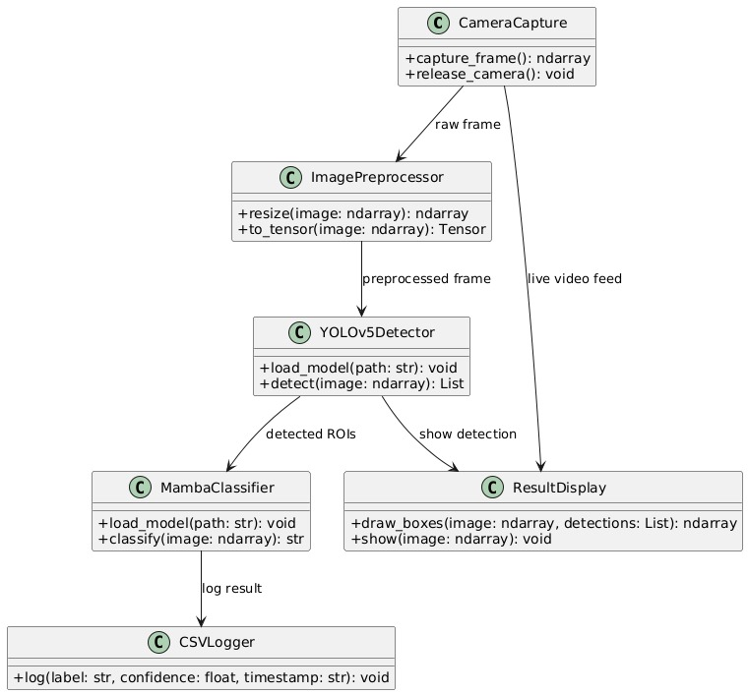
Class Diagram
Department Of Computer Science And Engineering

Slide 11
Class Diagram Explanation
Department Of Computer Science And Engineering
CameraCapture
  +capture_frame(): ndarray – Captures a frame from the camera.
  +release_camera(): void – Releases the camera after use.
ImagePreprocessor
  +resize(image: ndarray): ndarray – Resizes the image to the required input size.
  +to_tensor(image: ndarray): Tensor – Converts the image to tensor format for the model.
YOLOv5Detector
  +load_model(path: str): void – Loads the pre-trained YOLOv5 model.
  +detect(image: ndarray): List – Performs object detection on the image.
MambaClassifier
  +load_model(path: str): void – Loads the transformer-based classifier.
  +classify(image: ndarray): str – Classifies the detected object (e.g., stop sign, speed limit).
CSVLogger
  +log(label: str, confidence: float, timestamp: str): void – Logs the results with details like label, confidence, and time.
ResultDisplay
  +draw_boxes(image: ndarray, detections: List): ndarray – Draws bounding boxes and labels.
  +show(image: ndarray): void – Displays the annotated video frame in real-time.

Slide 12
Results & Outputs
Department Of Computer Science And Engineering
Comparison Table
Metric | Traditional CNN / YOLOv3 | Proposed (YOLOv5 + Mamba)
Detection Accuracy | ~85–88% | 93.6%
Classification Accuracy | ~85% Top-1 Accuracy | 91.2% Top-1 Accuracy
FPS (Real-Time) | ~15–20 FPS | 27–30 FPS
Latency per Frame | 60–80 ms | 35–40 ms
Precision | 85–88% | 92.5%
Recall | 84–87% | 90.8%
Robustness | Struggles in low light / blur | Stable under poor lighting, occlusion

Slide 13
Results & Outputs
Department Of Computer Science And Engineering
Visualization Output:
Bounding boxes and class labels are overlaid on detected signs.
Confidence scores are displayed alongside each label.
Detection Log File:
Results are exported in CSV format with label, confidence, and timestamp for each detection.
Model Robustness:
Successfully tested under various lighting conditions and camera angles.
Handles partial occlusion and blurred signs with reasonable accuracy.

Slide 14
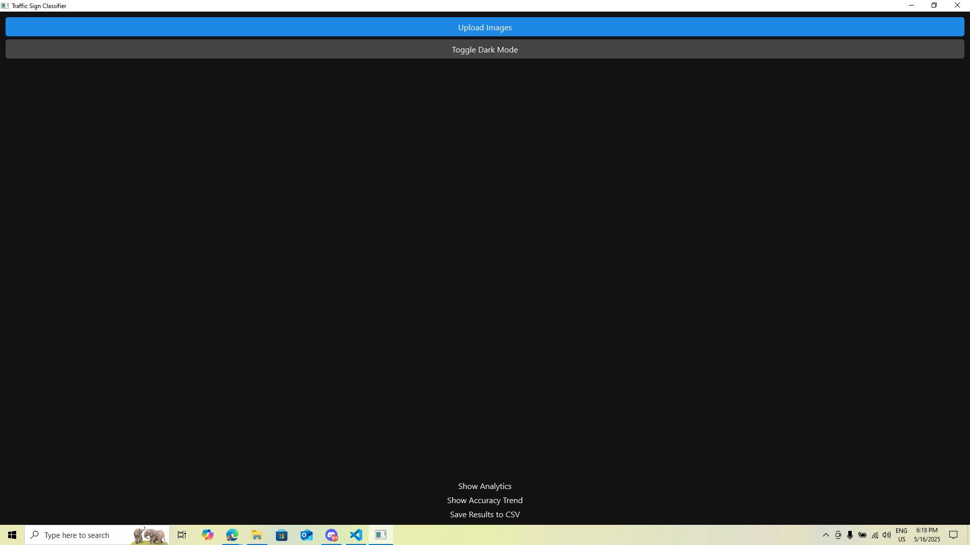
Index of Traffic Sign Classifier
Department Of Computer Science And Engineering

Slide 15
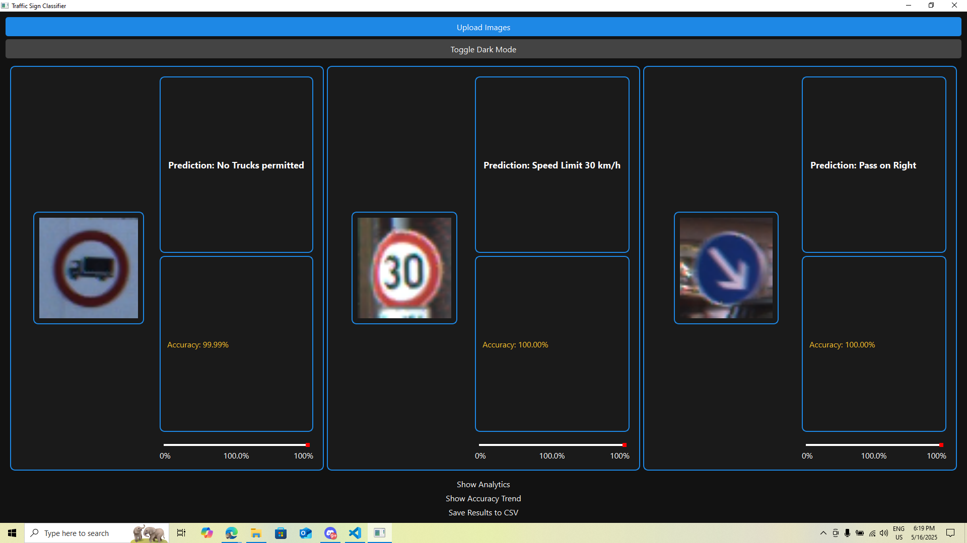
Output of Traffic Sign Classifier
Department Of Computer Science And Engineering

Slide 16
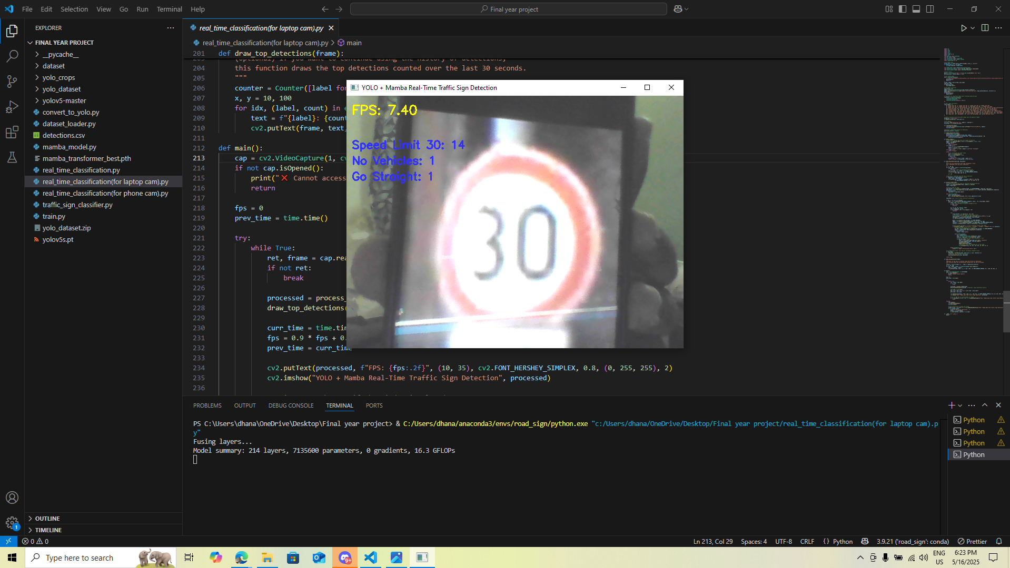
Output of Real Time Classification using Laptop Cam
Department Of Computer Science And Engineering

Slide 17
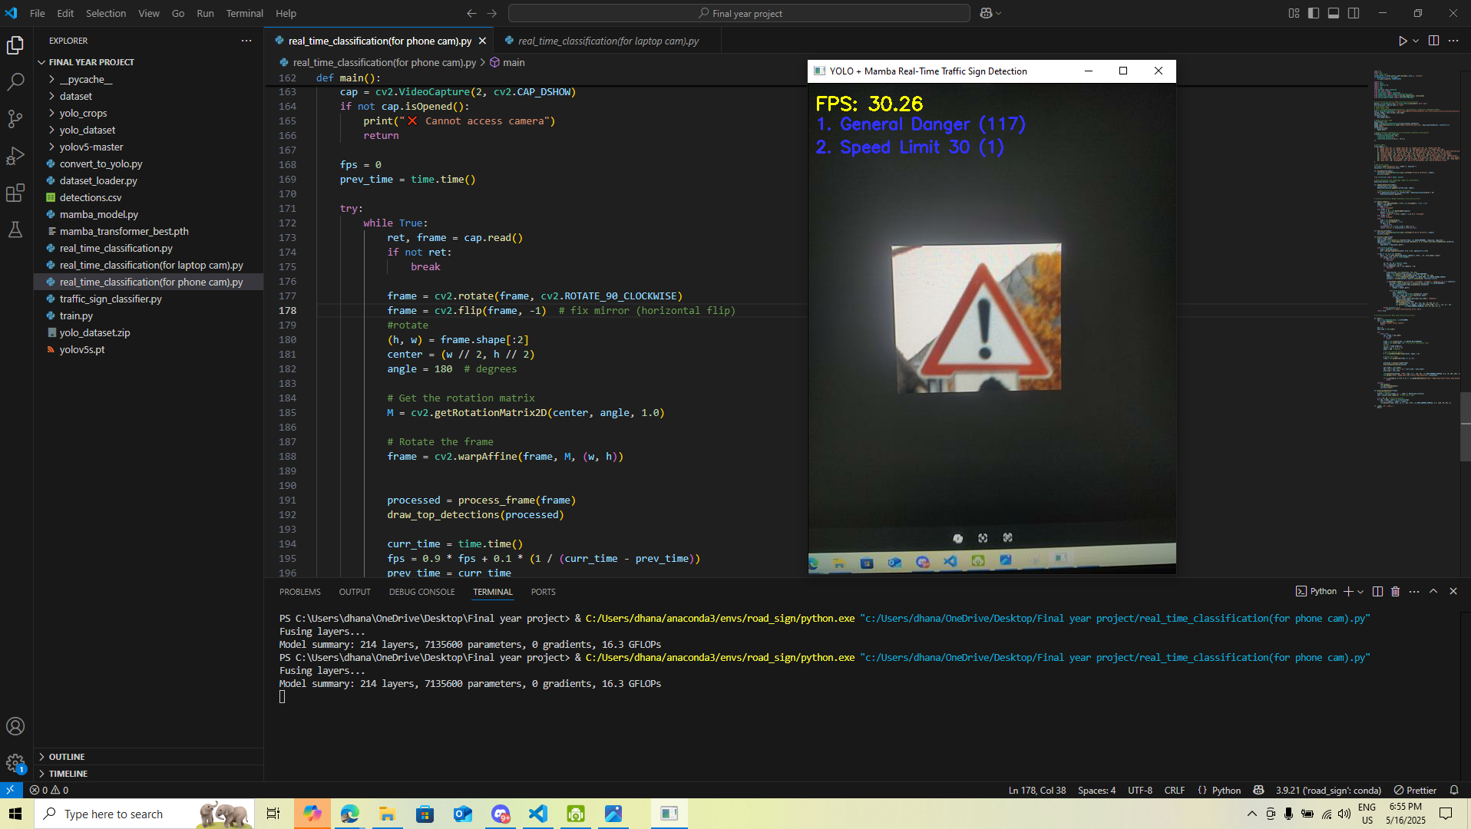
Output of Real Time Classification using Mobile Cam
Department Of Computer Science And Engineering

Slide 18
Conclusion
Department Of Computer Science And Engineering
Successfully built a real-time road sign detection system using YOLOv5 and Mamba Transformer.
Achieved high detection accuracy (93.6%) and classification accuracy (91.2%).
Demonstrated fast inference speed with 27–30 FPS, suitable for real-world use.
Mamba Transformer provided efficient classification with low latency and reduced computational load.
System remained robust in low light, blurred images, and partial occlusion scenarios.
Built a user-friendly GUI with PyQt5 and live camera support (laptop & mobile).
Logged detections with CSV reports and visual analytics using Matplotlib.
System is well-suited for edge devices and future integration with autonomous vehicles or smart city systems.

Slide 19
Future Scope
Department Of Computer Science And Engineering
Integration with IoT for smart traffic monitoring.
Deployment in self-driving cars for autonomous navigation
Augmented Reality (AR) for enhanced driver assistance.
Enable cloud-based analytics for large-scale traffic data monitoring and planning.
TinyML adaptation for ultra-low power devices.
Add multilanguage voice alerts to assist drivers with sign recognition feedback.

Slide 20
References
Department Of Computer Science And Engineering
Jocher, G., Stoken, A., Chaurasia, A., et al. — "YOLOv5," GitHub Repository and IEEE Preprint, 2020.
Zhang, H., Wu, C., Zhang, Z., et al. — "Mamba Transformer: Efficient Vision Transformer with Depthwise Separable Convolutions," IEEE Access, 2023.
Li, Y., Chen, Y., Wang, N., et al. — “Mamba Transformer: Efficient Transformer for Visual Recognition,” IEEE Transactions on Neural Networks and Learning Systems, 2023.
Li, W., Chen, K., Zhang, Y., & Wang, X. “Traffic Sign Recognition Based on Lightweight Transformer and Convolutional Neural Networks”
IEEE Transactions on Intelligent Transportation Systems, vol. 23, no. 4, 2022, pp. 3497-3508.

Slide 21
Department Of Computer Science And Engineering
Thank You

